Slide 1
GERMAN ERASMUS+ STUDENTS GESAMTSCHULE HEMER

Slide 2
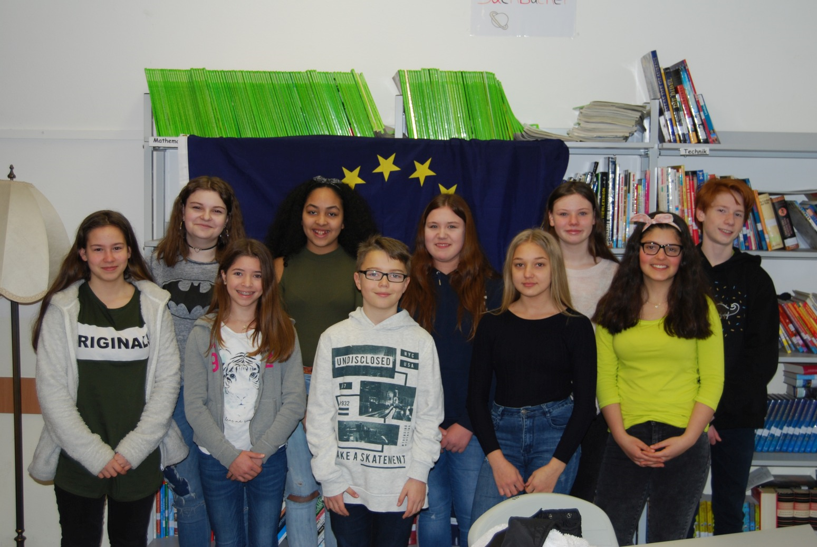
OUR STUDENTS

Slide 3
SEBASTIAN GEIGER
PARTNER COUNTRY:
LITHUANIA
AGE:
11
CLASS:
5E
FAVOURITE SUBJECTS:
MATHS AND P.E.
LANGUAGES:
GERMAN, ENGLISH, ITALIAN
HOBBIES AND INTERESTS:
FOOTBALL, RIDING MY BIKE

Slide 4
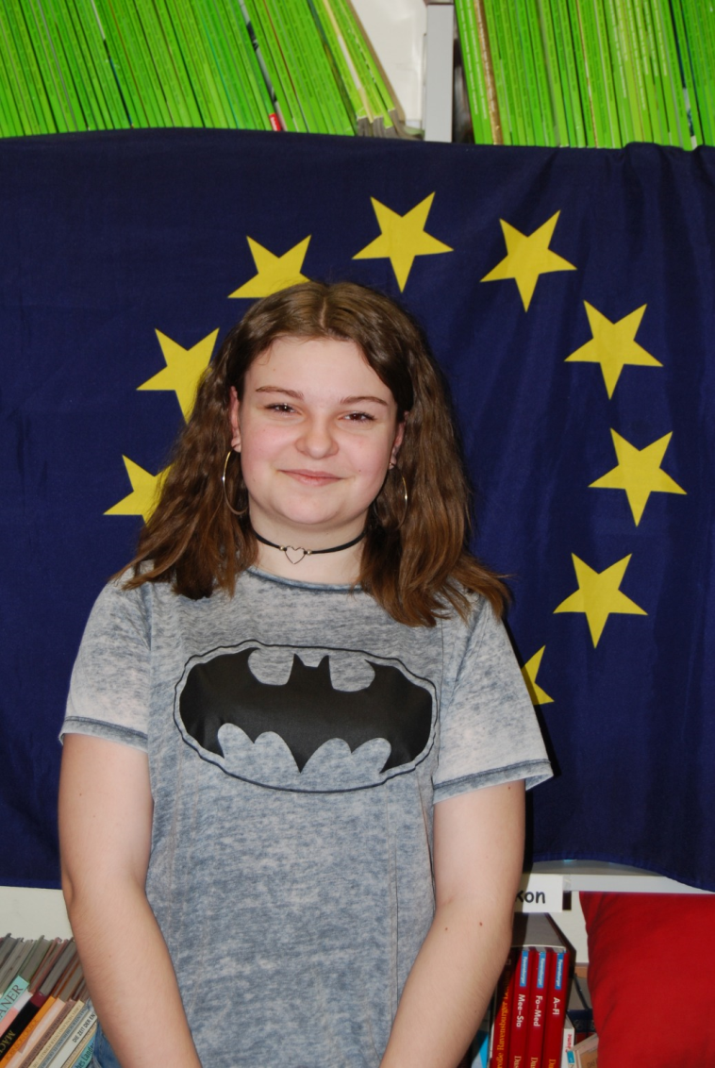
MANEESHA VOLKERTS
PARTNER COUNTRY:
LITHUANIA
AGE:
12
CLASS:
6E
FAVOURITE SUBJECTS:
ART, MUSIC, ENGLISH
LANGUAGES:
GERMAN, ENGLISH, SPANISH
HOBBIES AND INTERESTS:
DRAWING, MEETING FRIENDS, LISTENING TO MUSIC, DANCING

Slide 5
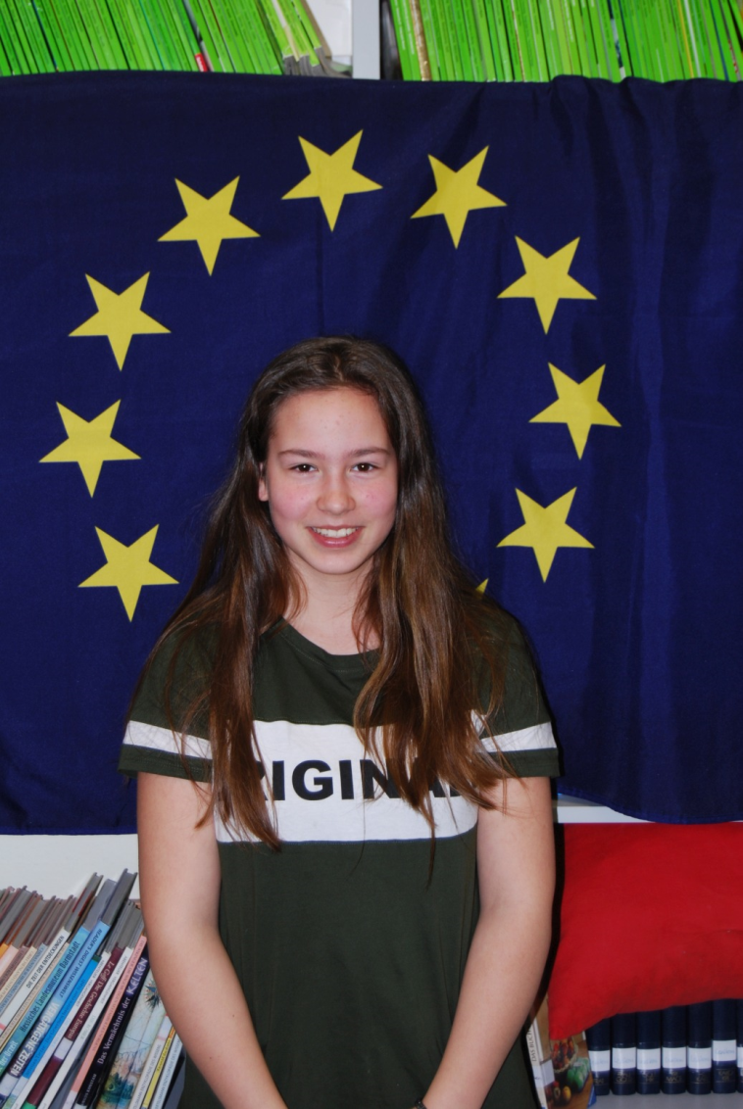
VALERIA MOLÉ
PARTNER COUNTRY:
LITHUANIA
AGE:
12
CLASS:
6E
FAVOURITE SUBJECTS:
ART, ENGLISH, P.E.
LANGUAGES:
GERMAN, ENGLISH, SPANISH
HOBBIES AND INTERESTS:
FOOTBALL, DRAWING

Slide 6
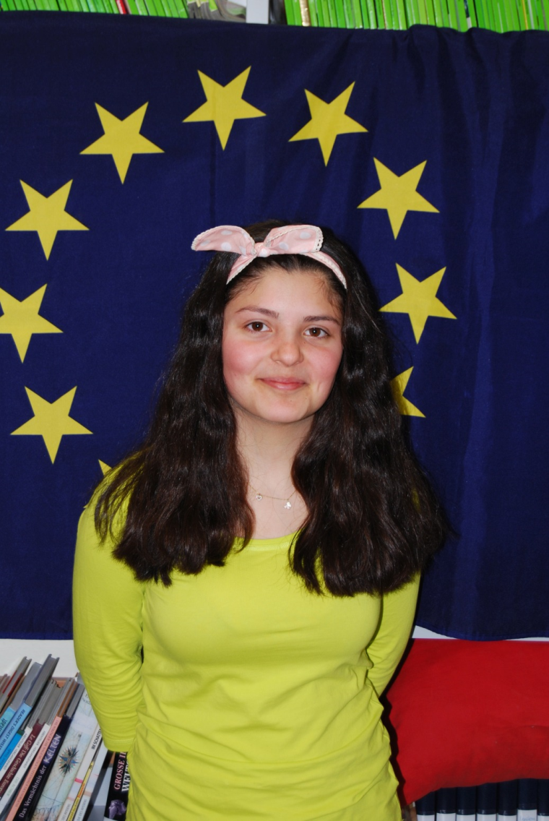
HIDAYET MELISSA ÖZGÜL
PARTNER COUNTRY:
GREECE
AGE:
14
CLASS:
8D
FAVOURITE SUBJECTS:
MATHS, P.E.
LANGUAGES:
GERMAN, ENGLISH, TURKISH
HOBBIES AND INTERESTS:
CULTURES, MOVIES, MEETING FRIENDS

Slide 7
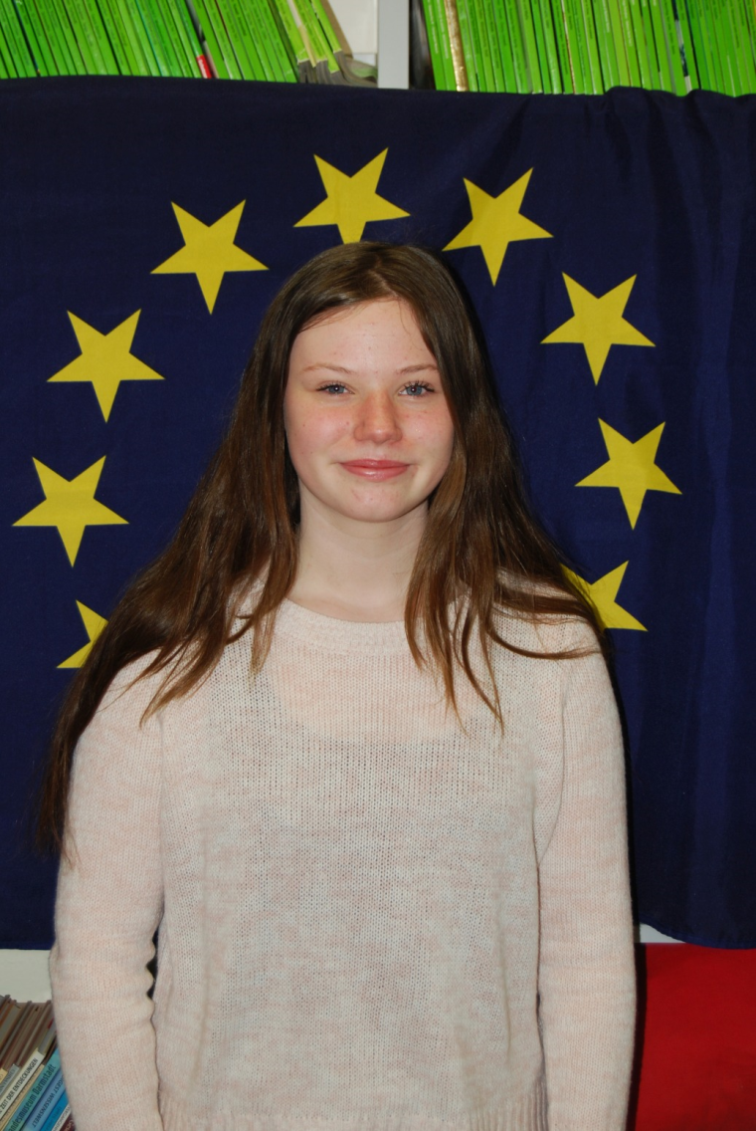
ALINA KÖSTER
PARTNER COUNTRY:
GREECE
AGE:
13
CLASS:
8B
FAVOURITE SUBJECTS:
MATHS, FRENCH
LANGUAGES:
GERMAN, ENGLISH, FRENCH
HOBBIES AND INTERESTS:
HANDBALL

Slide 8
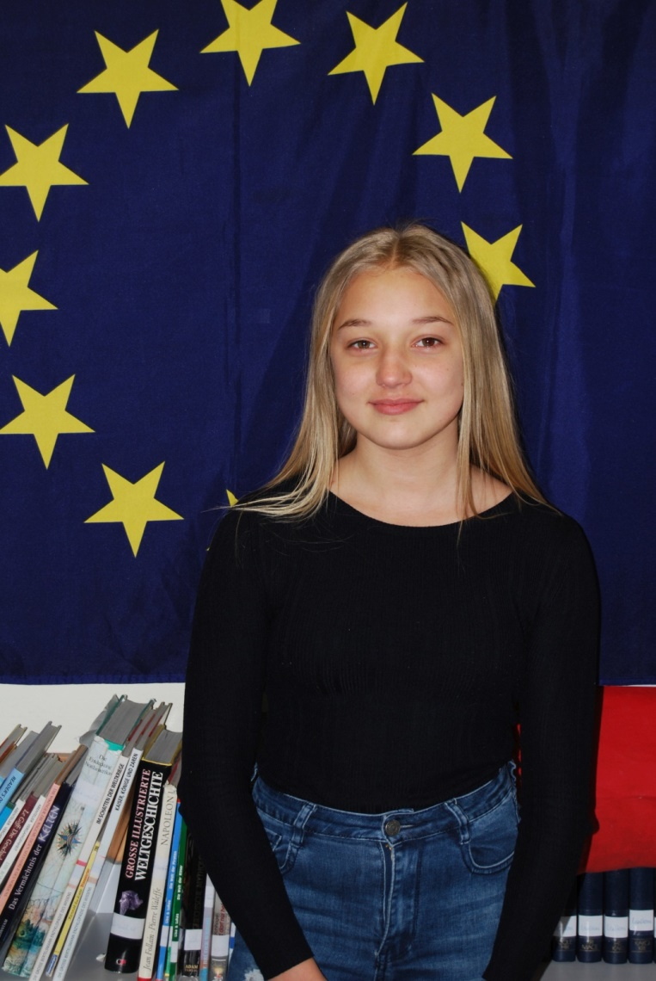
MARIE STRACKE
PARTNER COUNTRY:
GREECE
AGE:
14
CLASS:
8B
FAVOURITE SUBJECTS:
ENGLISH, SPANISH, P.E.
LANGUAGES:
GERMAN, ENGLISH, SPANISH
HOBBIES AND INTERESTS:
SPORTS

Slide 9
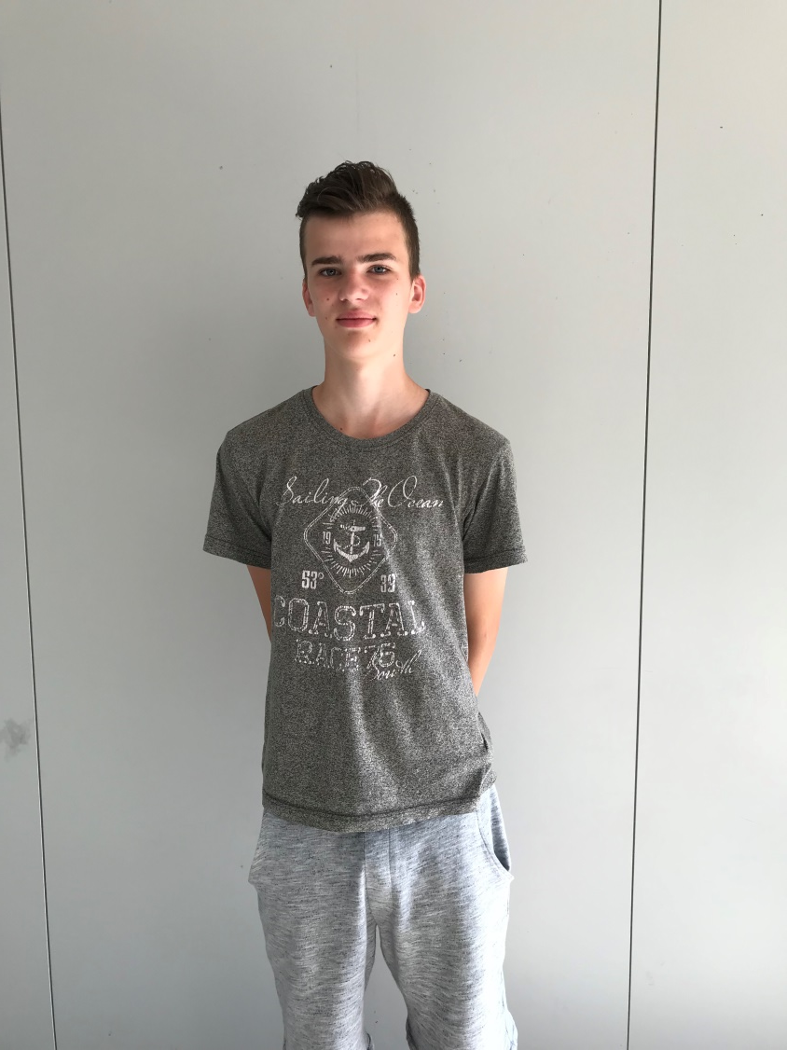
OLE BRÖMMELMEIER
PARTNER COUNTRY:
POLAND
AGE:
13
CLASS:
7E
FAVOURITE SUBJECTS:
P.E.
LANGUAGES:
GERMAN, ENGLISH
HOBBIES AND INTERESTS:
FOOTBALL

Slide 10
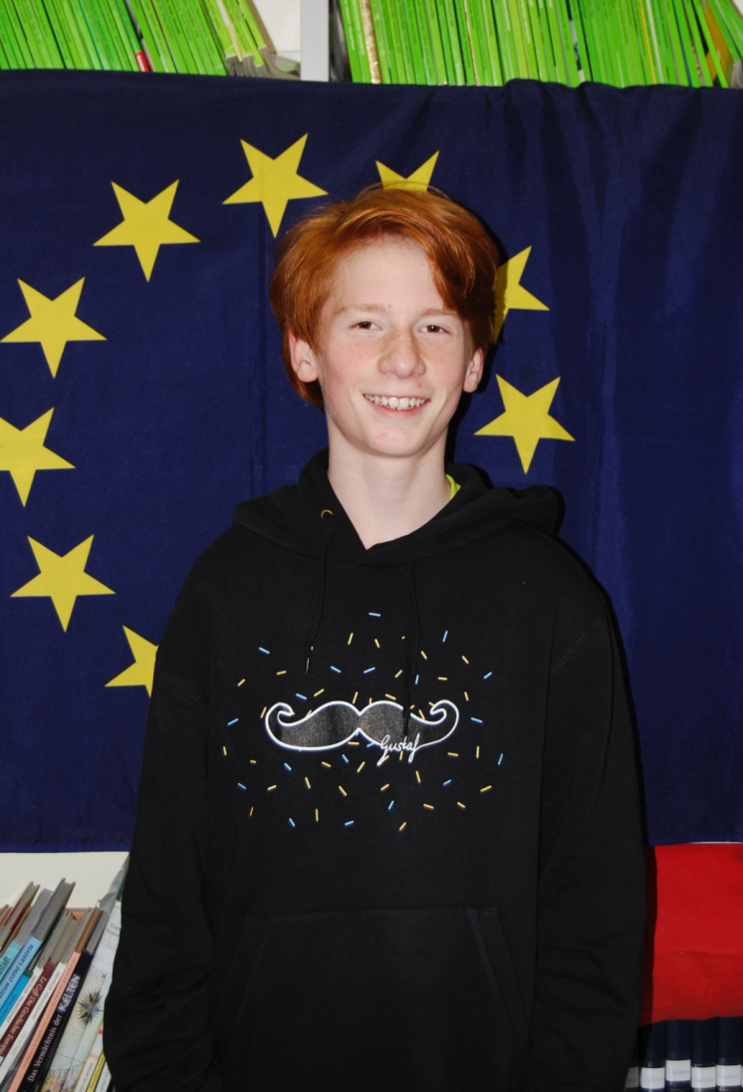
MANUEL GANZER
PARTNER COUNTRY:
POLAND
AGE:
12
CLASS:
7E
FAVOURITE SUBJECTS:
P.E., MATHS
LANGUAGES:
GERMAN, ENGLISH, LATIN
HOBBIES AND INTERESTS:
GAMING, RIDING MY BIKE, PLAYING BASKETBALL

Slide 11
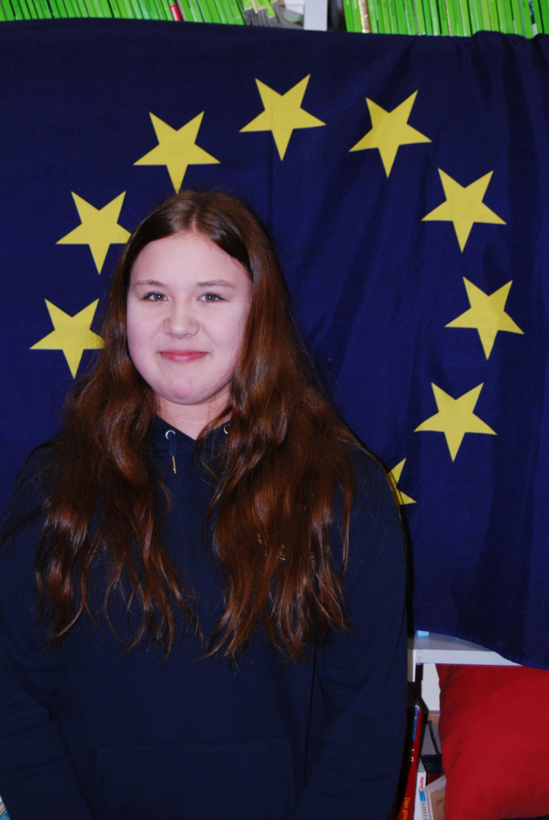
MARIE HUYBERS
PARTNER COUNTRY:
POLAND
AGE:
14
CLASS:
8E
FAVOURITE SUBJECTS:
P.E.
LANGUAGES:
GERMAN, ENGLISH, FRENCH
HOBBIES AND INTERESTS:
MEETING FRIENDS, CHATTING WITH FRIENDS

Slide 12
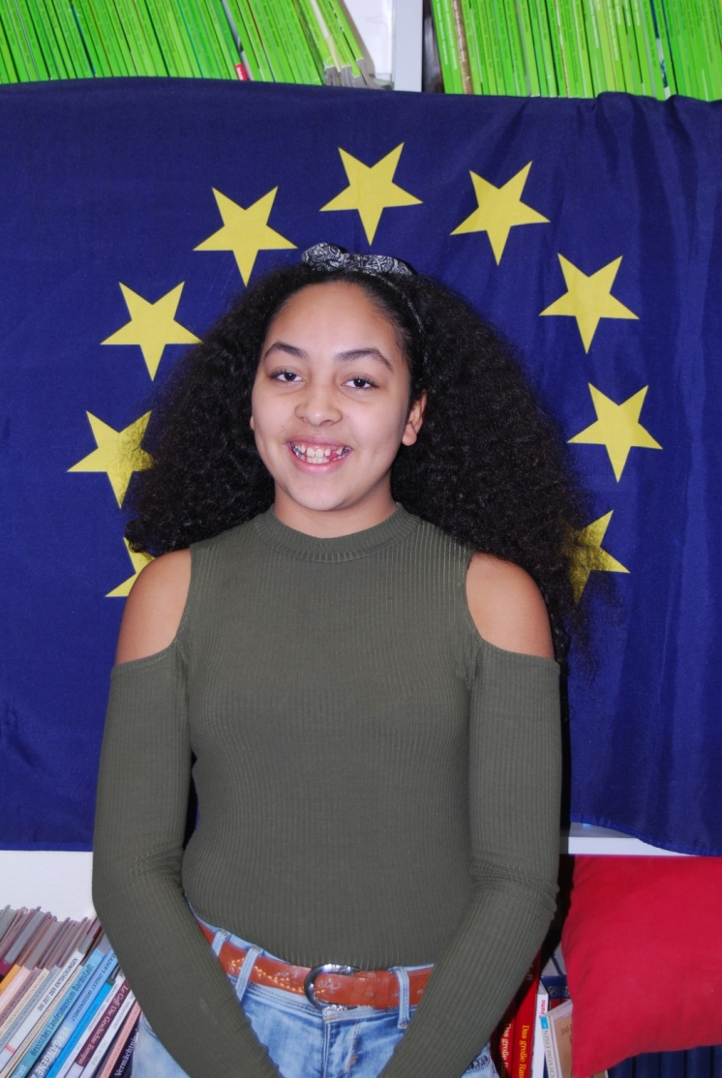
MAYA BOECKER
PARTNER COUNTRY:
PORTUGAL
AGE:
12
CLASS:
7B
FAVOURITE SUBJECTS:
COOKING, ART, P.E., MATHS
LANGUAGES:
GERMAN, ENGLISH, SPANISH, PORTUGUESE
HOBBIES AND INTERESTS:
DANCING, BAKING, DRAWING

Slide 13
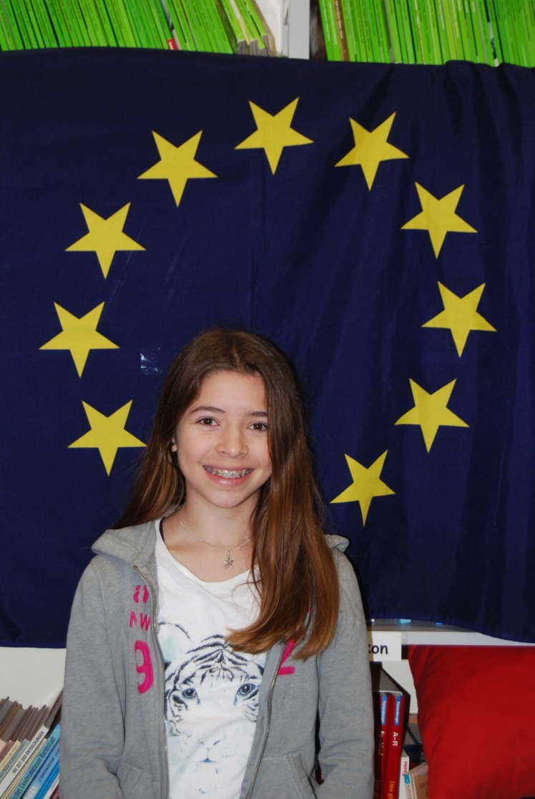
ANOUK BLÜMER
PARTNER COUNTRY:
PORTUGAL
AGE:
13
CLASS:
7B
FAVOURITE SUBJECTS:
HOME ECONOMICS, ART, P.E., MATHS
LANGUAGES:
GERMAN, ENGLISH, SPANISH
HOBBIES AND INTERESTS:
DANCING, BAKING, VOLLEYBALL, GYMNASTICS, DRAWING

