Slide 1
GERMAN ERASMUS+ TEAM GESAMTSCHULE HEMER

Slide 2
BIRGIT KLÜTER-KLEIN
PROFESSION:
TEACHER AND COORDINATOR FOR THIS ERASMUS PROJECT
SUBJECTS:
ENGLISH AND SPANISH
EXPERIENCE:
HEAD OF THE WORKGROUP „ARBEITSKREIS EUROPA“.
COORDINATOR OF COMENIUS AND ERASMUS PROJECTS.
ORGANISATION OF FIELD TRIPS TO ENGLAND AND SPAIN.
TRAINED IN E-TWINNING.
INTERESTS:
READING, TRAVELLING, SPORTS, MUSIC.

Slide 3
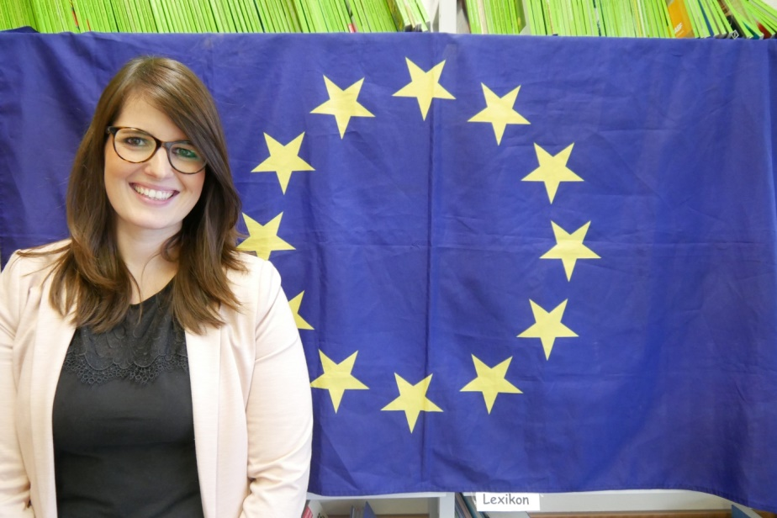
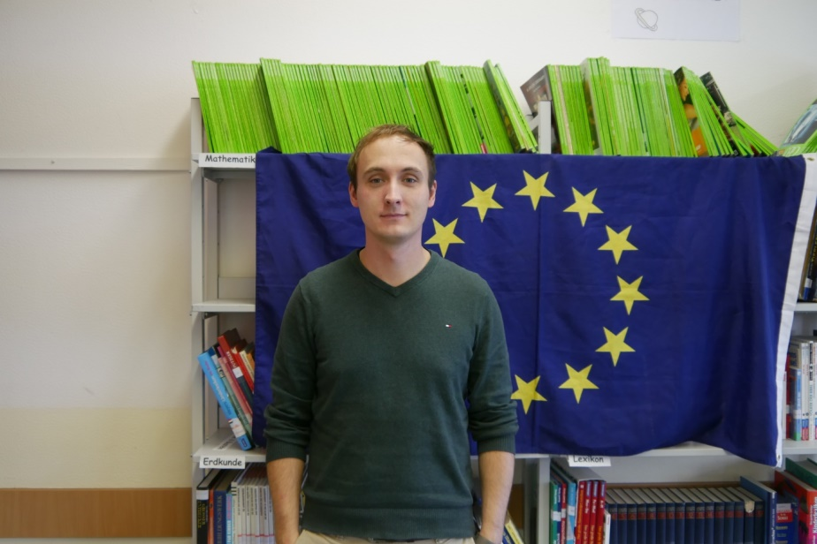
KATHARINA FISCHER
PROFESSION:
TEACHER
SUBJECTS:
ENGLISH, RELIGIOUS STUDIES, TECHNOLOGY
EXPERIENCE:
ORGANISATION OF THE STUDENT EXCHANGE WITH ITALY AND FIELD TRIPS TO ENGLAND.
INTERESTS.
TRAVELLING, READING, BAKING.

Slide 4
MARC HÖGEMANN
PROFESSION:
TEACHER
SUBJECTS:
ENGLISH AND HISTORY
EXPERIENCE:
ORGANISATION OF A FIELD TRIP TO ENGLAND.
TEACHING BILINGUAL COURSES AT OUR SCHOOL.
COORDINATOR FOR THE COMPUTER LABS AT OUR SCHOOL.
INTERESTS:
MOTORCYCLING, PLAYING VIDEO GAMES, TECHNOLOGY.

Slide 5
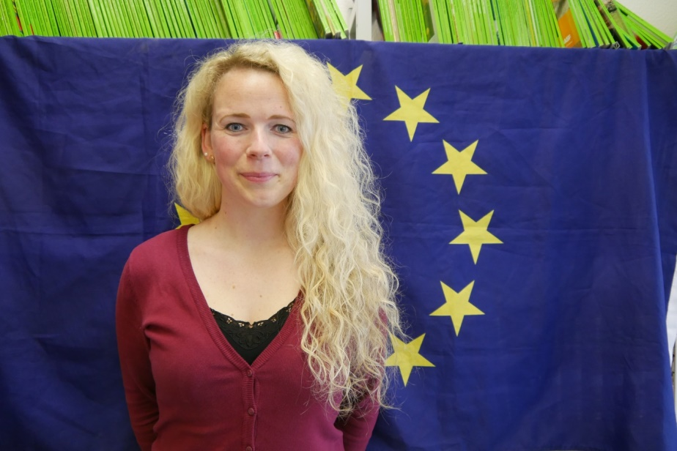
SABRINA KALTENBACH
PROFESSION:
TEACHER
SUBJECTS:
ENGLISH AND SPAIN
EXPERIENCE:
ORGANISATION OF AN EDUCATIONAL INTERNSHIP FOR STUDENTS IN ITALY.
ORGANISATION OF A FIELD TRIP TO MADRID.
TRAINED IN FOREIGN LANGUAGE CERTIFICATES (DELE AND CAMBRIDGE)
INTERESTS:
DANCING, SHOPPING, TRAVELLING.

Slide 6
KRISTINA KNOX
PROFESSION:
TEACHER TRAINEE
SUBJECTS:
FRENCH AND HISTORY
EXPERIENCE:
ORGANISATION OF EDUCATIONAL ACTIVITIES FOR STUDENTS
INTERESTS:
CLIMBING, ATHLETICS , READING, TRAVELLING.

Slide 7
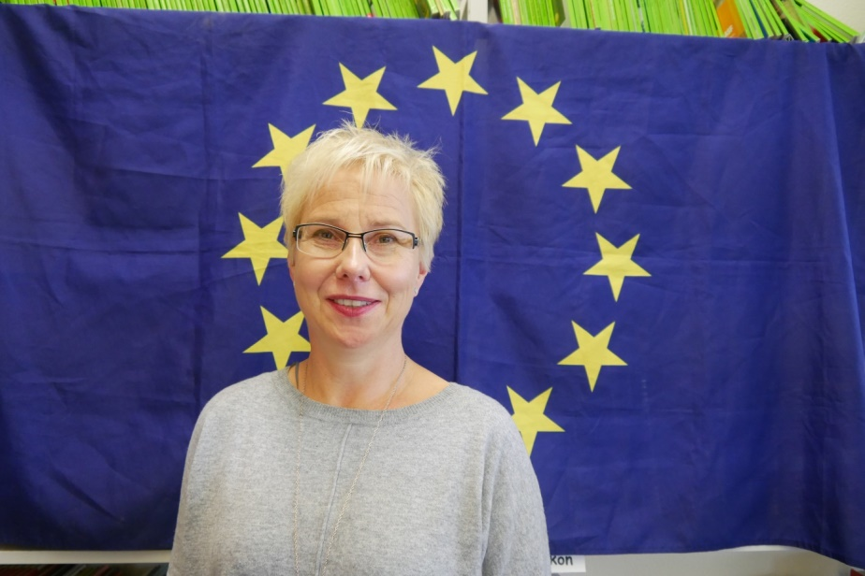
FRIEDERIKE MICHEL-SCHULER
PROFESSION:
TEACHER
SUBJECTS:
ENGLISH AND GERMAN
EXPERIENCE:
FORMER COORDINATOR FOR EUROPEAN ISSUES AND FOR BILINGUAL COURSES AT OUR SCHOOL .
PARTICIPATION IN A COMENIUS PROJECT.
ORGANISATION OF THE STUDENT EXCHANGE WITH POLAND.
TRAINED IN E-TWINNING.
INTERESTS:
READING, COOKING, DANCING, TRAVELLING.

Slide 8
LUKAS SEIFERT
PROFESSION:
TEACHER
SUBJECTS:
P.E. AND HISTORY
EXPERIENCE:
ORGANISATION OF EDUCATIONAL ACTIVITES FOR STUDENTS
INTERESTS:
TRAVELLING, TRIATHLON, MUSIC.

